Slide 1

INDIAN AGRICULTURE CROP ANALYSIS-1997 to 2021
NAAN MUDHALVAN

Slide 2
TEAM MEMBERS
M.Anandhi
A.Jayaraman
S.Myli
D.Kalaivani
N.S.Charumathi

Slide 3
STARTUP ANALYSIS
Introduction
Problem definition and design thinking
Advantages and disadvantages
Applications
Future scope
Step in tableau, dashboard, story
Conclusion

Slide 4
Problem definition
Agricultural yield in India is still low in comparison to other countries of the world. This is caused due to several factors. These factors can be categorized into four groups:
(i) environmental (ii) economic (iii) institutional (iv) technological
The Union Government announced the National Agricultural Policy (NAP) envisaging over 4 per cent growth rate per annum. The policy seeks to promote technically sound, economically viable, environmentally non-degrading, and socially acceptable use of country's natural resources - land, water and genetic endowment to promote sustainable development of agriculture.

Slide 5
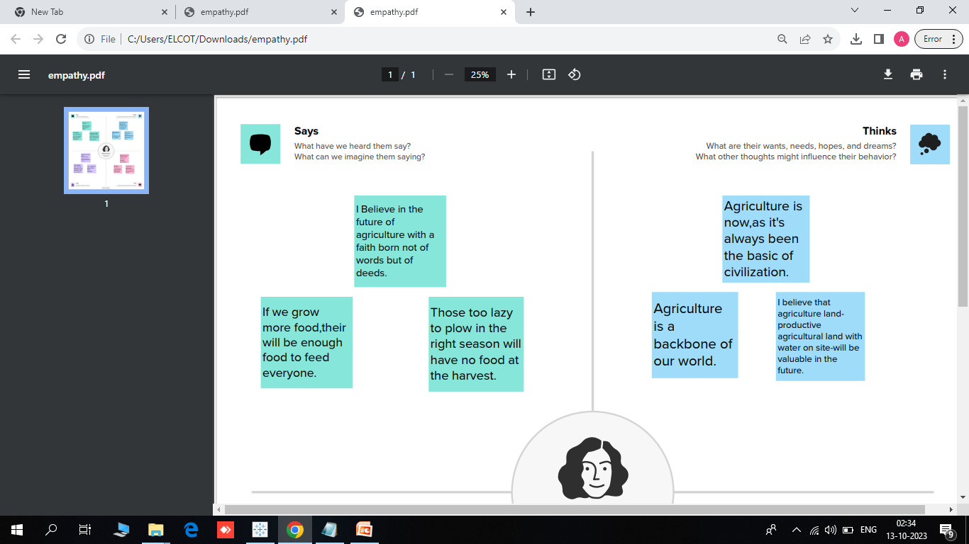
Empathy Map
We have done by empathy map for better under standing of a problems

Slide 6
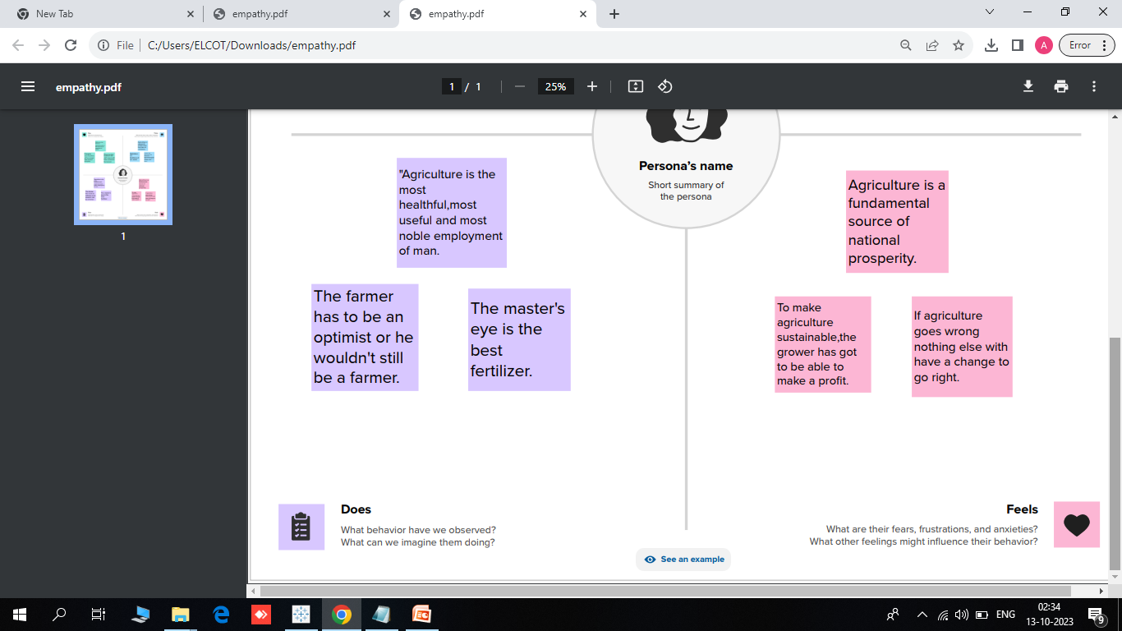

Slide 7
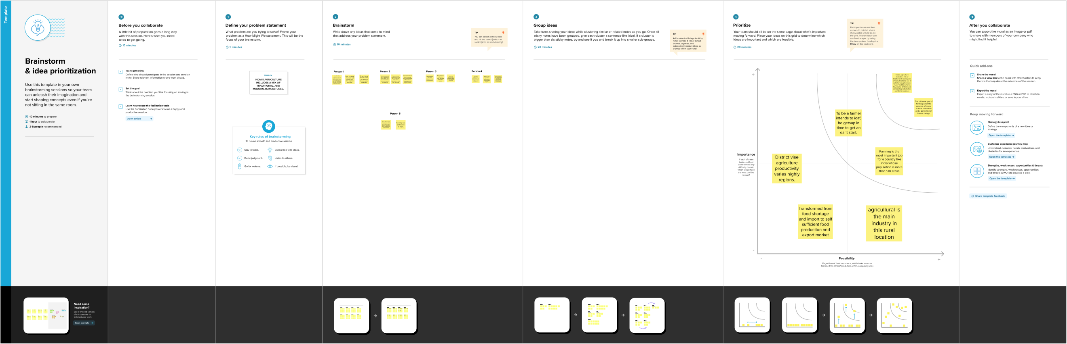
Brainstorming As team we made collect point and given according to person

Slide 8
ADVANTAGES and DISADVANTAGES
ADVANTAGES
Controllable food supply. You might have droughts or floods, but if you’re growing the crops and breeding them to be hardier, you have a better chance of not starving.
Especially if you grow grain, you can create a food surplus, which makes cities possible and also the specialization of labor.
DISADVANTAGES
In order to keep feeding people as the population grows you have to radically change the environment of the planet.
Farming is hard. So hard, in fact, that one is tempted to claim ownership over other humans and then have them till the land.’

Slide 9
APPLICATION AND FUTURE SCOPE
Application:
Indian farmers are people who grow crops as a profession.^{[10]} Various government estimates (Census, Agricultural Census, National Sample Survey assessments, and Periodic Labour Force Surveys) give a different number of farmers in the country ranging from 37 million to 118 million as per the different definitions.
Future Scope :
Agriculture sector have an enormous scope in India as of the future refrence because agriculture sector is the largest sector with 49% of country's population works in Agriculture sector by occupation. India is also a developing country with about 16% of its GDP is contributed by this sector.

Slide 10
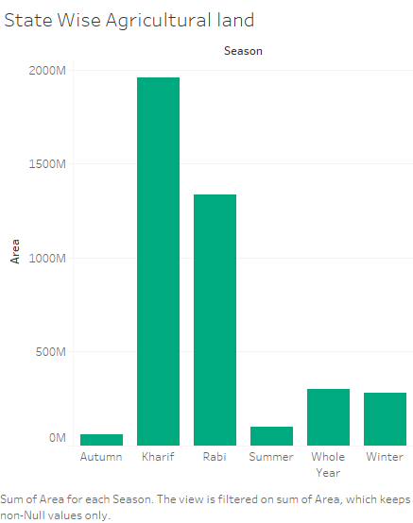

Slide 11
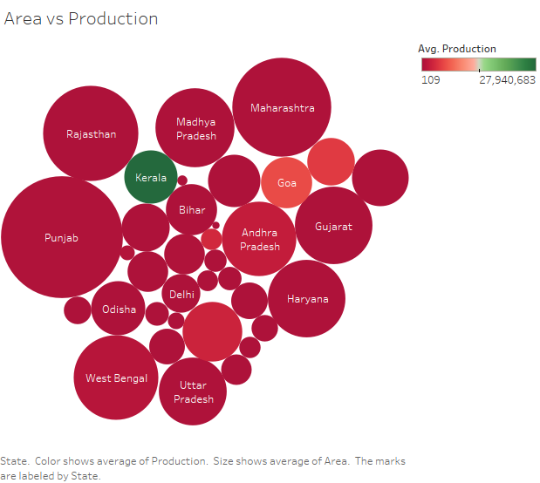

Slide 12
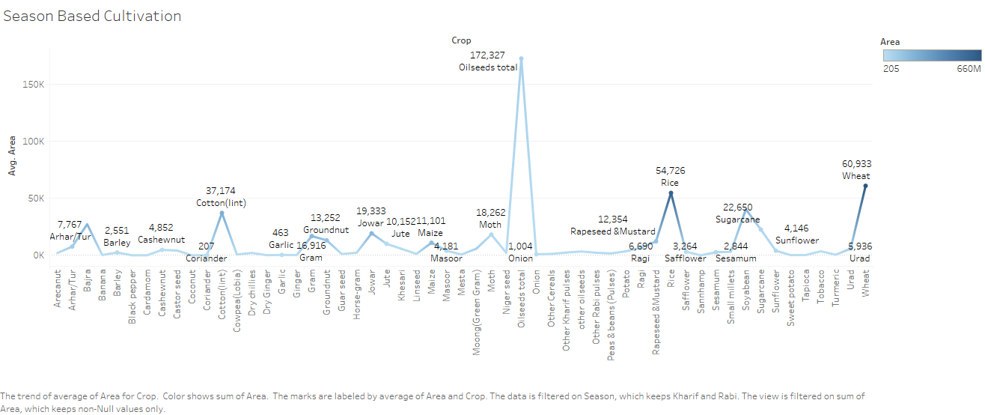

Slide 13
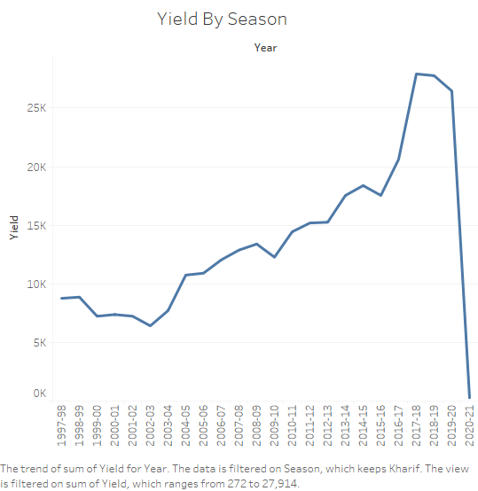

Slide 14
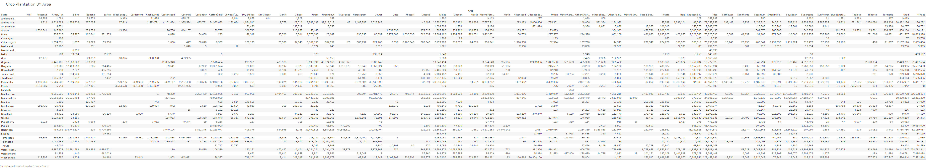

Slide 15
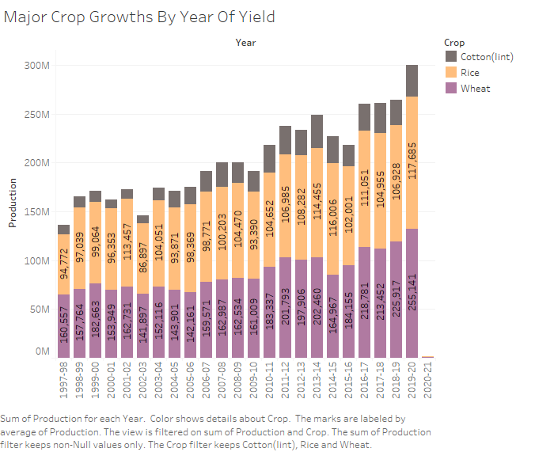

Slide 16
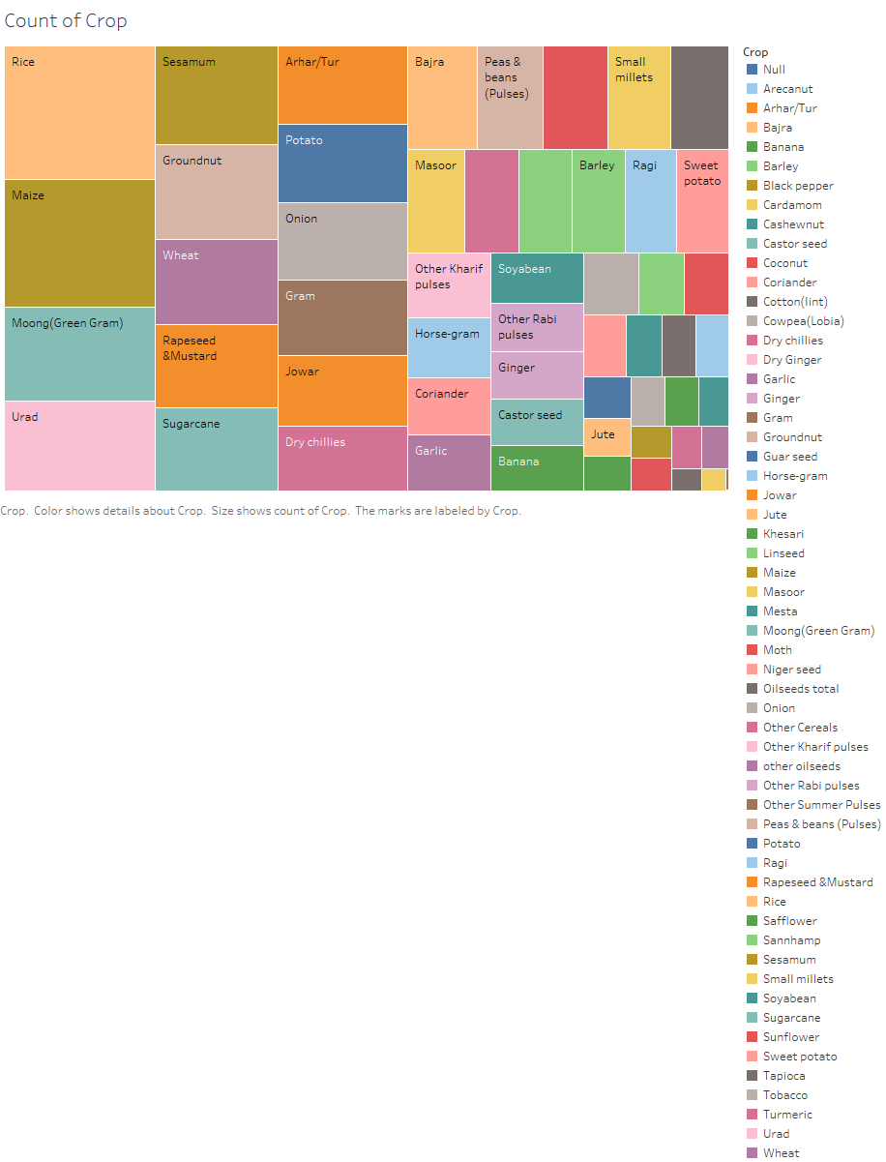

Slide 17
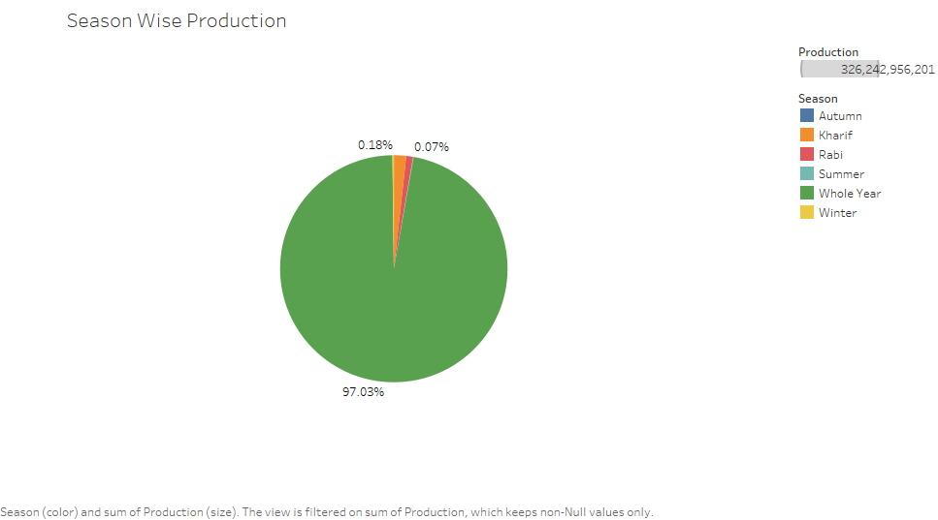

Slide 18
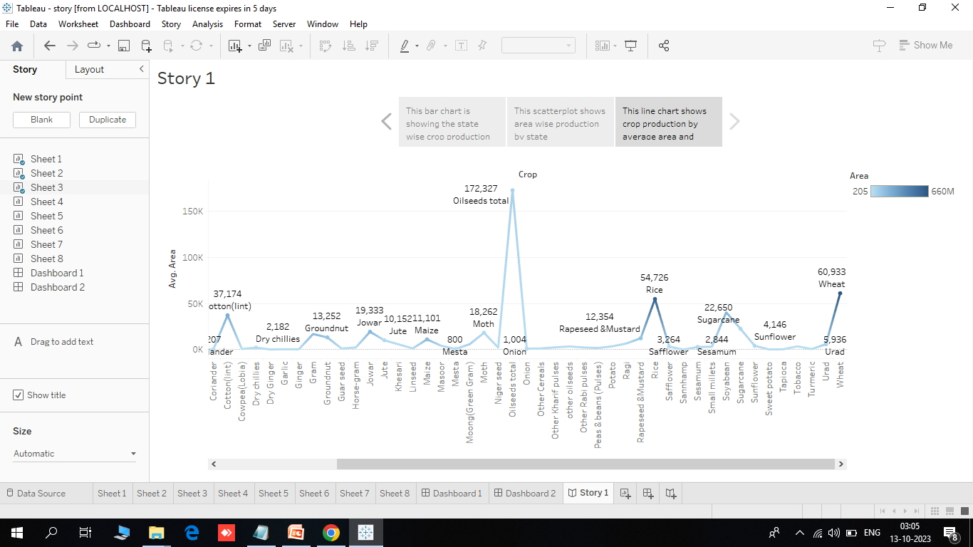
STORY

Slide 19

CONCLUSION
Agriculture is an integral part of smart growth. The ability to feed one's own population is critical to the independence of any state.
Ontario is blessed with resources that have facilitated the development of a world class agricultural industry that provides safe, nutritious, and reliable food.
The ability to feed the local population from local sources should not be underestimated.

